Slide 1
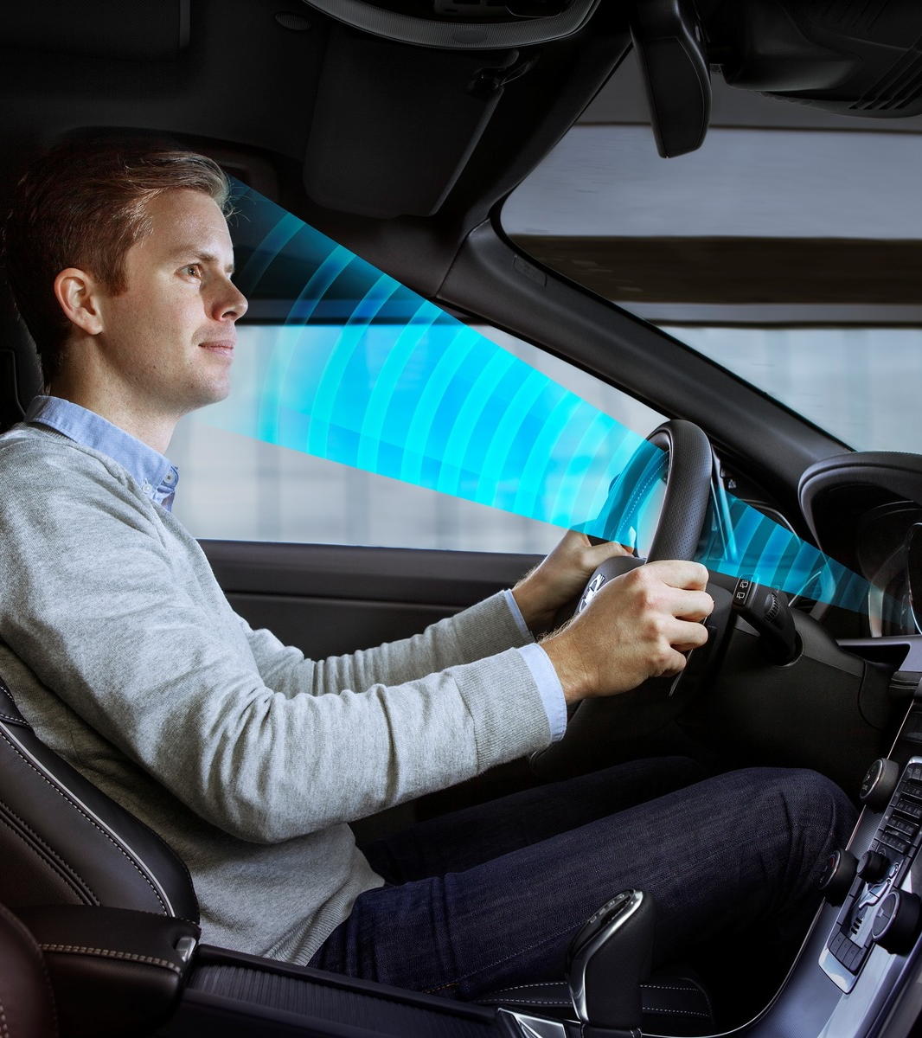


Driver Drowsiness Detection System
Students Details →
Name: Ajay Ashok Walke
MIS: 112015006
Supervisor: Dr. Tanmoy Hazra

Slide 2
Flow of PPT
Abstract
Introduction
Motivation
Literature Review
Methodology
Proposed Work
Results
Implementation
conclusion

Slide 3
Abstract

Slide 4
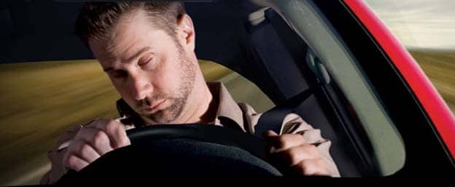
Abstract
Mentioned techniques detect the drivers’ fatigue status
In a drivers state of fatigue, facial expressions are differ than normal state
Model is capable of sensing the entire range of stages
low-cost driver fatigue level prediction framework (DFLP)
Fatigue is serious cause in deadly car and motorcycles accidents

Slide 5
Introduction

Slide 6
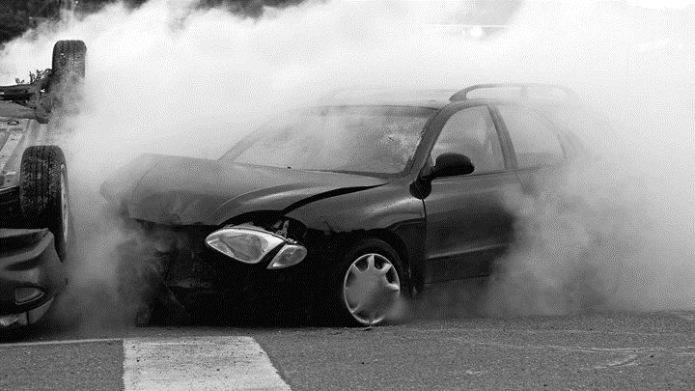

Introduction
An increasing demand for modern transportation necessitates faster car growth causing automobile is an essential mode of transportation for people
It is also associated with numerous negative effects, such as traffic accidents
A report by the National Highway Traffic Safety Administration showed that a total of 4,49,002 traffic accidents occurred in the India in 2019, resulting in 1,51,113 deaths and 4,51,361 injuries
Driver’s physiological factors such as heart rate brain waves, and electroencephalogram are monitored by various system

Slide 7
Motivation

Slide 8

Motivation
Driver drowsiness is a significant factor in the increasing number of accidents on today’s roads and it is underestimated
The automobile business also has tried to build several systems to predict driver drowsiness but there are only a few commercial products available today.
So far, researchers have tried to model the behavior by creating links between drowsiness and certain indications.
The systems do not look at driver performance and overlook driver ability and characteristics also people drive differently.

Slide 9
Literature Review

Slide 10
Literature Review
In Jul-Aug 2015, Chisty et. al. described ‘A Review: Driver Drowsiness Detection System’
In May 2019, Muhammad Ramzan et. al. described ‘A Survey on State-of-the-Art Drowsiness Detection Techniques’
In August 2019, Wanghua Deng et. al. described ‘Real-Time Driver-Drowsiness Detection System Using Facial Features’
In December 2019, Mika Sunagawa et. al. described ‘Comprehensive Drowsiness Level Detection Model Combining Multimodal Information’
In August 2021, Morshed Chowdhury et. al. described ‘Drivers Fatigue Level Prediction Using Facial, and Head Behavior Information’

Slide 11
Methodology

Slide 12
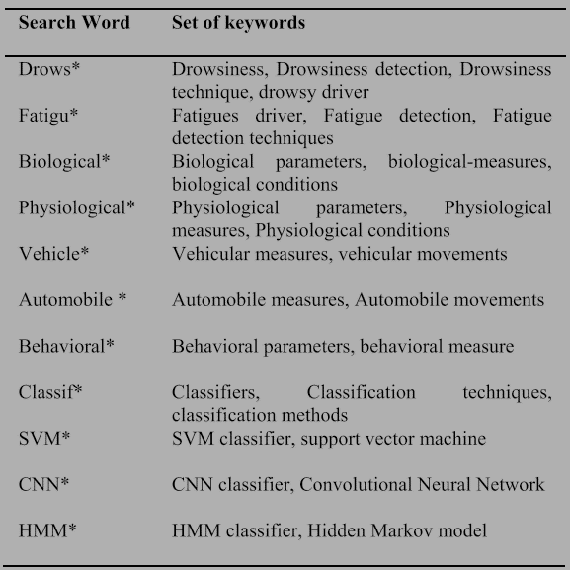

Methodology
All the best possible techniques, measures, tools, and classification methods for drivers’ drowsiness detection are recognized and categorized
All the data gathered from research papers are categorized
The websites containing information regarding road safety, dangers of driver’s fatigue, reasons for fatigue, and techniques, keywords are listed in the following figure.

Slide 13
Using multimodal information
(3 paper)
Using behavioral, vehicular & phycological parameter
(5 paper)
Furthermore using facial and head features et. Al. parameter
(4 paper)
Driver Drowsiness Detection System
Using hybrid machine learning
(2 paper)
Final Work Layout

Slide 14
Proposed Work

Slide 15
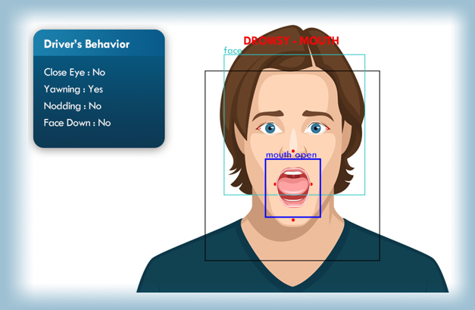
Proposed Work
01.
Behavioral parameter-based techniques
02.
Vehicular parameter-based techniques
03.
Physiological parameter-based techniques

Slide 16

PERCLOS
LDWS
SVM
Used to determine the position of the vehicle on the road
Warn the driver when the vehicle is on a white line
Predict when the driver is in danger of departing from the road
Used for the selection of the training data set in a pre-defined form of data
Haar feature algorithm is used for the detection of the Eyes and face
Video-based method that measures eye closure
It is most reliable and valid measure for eye detection

Slide 17
HMM
CNN
Predict the hidden state based on the observed state
IR webcam is used to eliminate the day-night effect
like a standard neural network
Uses the layers of the spatial convolution
Viola and Jones algorithm is used to detect the face

Slide 18
Drowsiness Detection Technique
(DDT)
Behavioral Parameters
Physiological Parameters
Vehicular Parameters
HMM
SVM
CNN
Eye Tracking
Yawning
Face components
Head movements
Eye closeness duration
Eye blinking, eye state
Heart rate analysis
Heart pulse wave
Breathing rate
Stress level
Core body temperature
Lane Detection
Eye blinking duration
Steering wheel behavior
Steering wheel angle
Eye state
Eye closure
Eye blink
Head position

Slide 19
Results

Slide 20
Results
01.
02.
03.
04.
Predicting drivers’ fatigue is more important than just detecting fatigue, due to the fact that prediction could give a bigger window for drivers to act upon a sudden hazard.
The fatigue classification method is into two classifications: drowsy, and alert.
The data was obtained from an HRV in the form of EEG epochs. Their study concluded that deep covariance learning methods reported better performance than shallow learning methods and that was through using a CNN model.
The study has successfully improved the accuracy from 70.96% to 86.14%. Drowsiness detection systems using SVM are overall 98.4% accurate, and by using HMM it is 99.7% accurate.

Slide 21
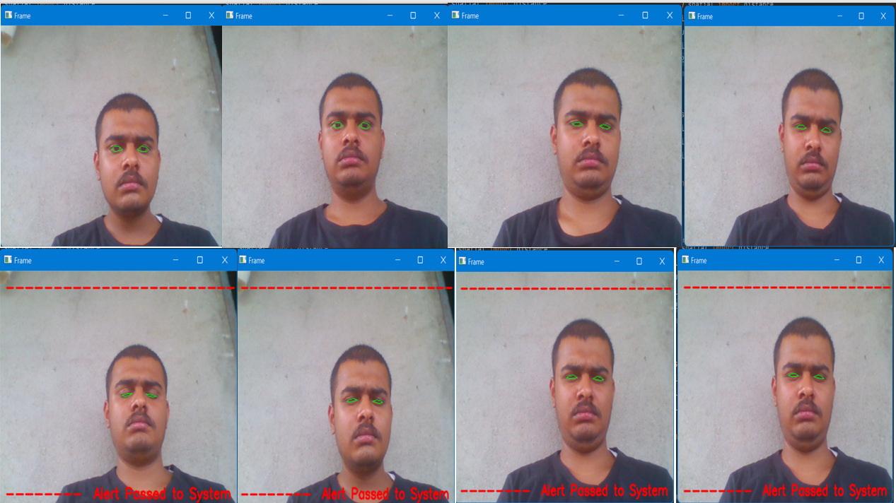
Implementation
Following are the results of the code in the python implementation of the paper Real-Time Eye Blink Detection Using Facial Landmarks to detect Driver Drowsiness and raise an alert. Dataset of the program:

Slide 22
Drawbacks

Slide 23

Drawbacks
In PERCLOS, a driver who is trying to stay awake can fall asleep with his eyes open
In LDWS, warning signal is given every time the driver crosses the line, not intentional
In SVM, result is achievable in the lower frame rate
In HMM, older people have a deeper wrinkle
In eye detection system, detection almost impossible when the driver is wearing sunglasses

Slide 24
Conclusion

Slide 25
Conclusion
The systematic review provides details of behavioral, vehicular, and physiological parameters-based drowsiness detection techniques
The comparative analysis showed that none of these techniques provide full accuracy, but physiological parameters-based techniques give more accurate results than others
SVM is the most commonly used classifier which gives better accuracy and speed in most situations
HMM shows a less error rate, but both CNN and HMM are slow in training and expensive as compared to the SVM classifier

Slide 26
Future Work

Slide 27

Future Work
Future works may focus on the utilization of outer factors for fatigue measurement
Twenty-four-hour operations, high annual mileage, exposure to challenging environmental conditions, and demanding work schedules all contribute to this serious safety issue.
Monitoring the driver’s state of drowsiness and providing feedback on their condition so that they can take appropriate action is one crucial step in a series of preventive measure
Currently, there is no adjustment in zoom or direction of the camera during operation.

Slide 28
References
Chisty et. al. http://www.ijcstjournal.org/volume-3/issue-4/IJCST-V3I4P38.pdf
Muhammad Ramzan et. Al. https://ieeexplore.ieee.org/document/8704263
Wanghua Deng et. al. https://ieeexplore.ieee.org/document/8808931
Mika Sunagawa et. al. https://ieeexplore.ieee.org/document/8933427
Morshed Chowdhury et. al. https://ieeexplore.ieee.org/document/9524576
reference web. https://www.ukessays.com/essays/information-technology/motivation-for-drowsiness-detection-information-technology-essay.php#citethis
Source code: https://github.com/AjayWalke/Driver-Drowsiness-Dtection-System-BTP---2-Year

Slide 29
Thank You

